Slide 1


Network protocols & security
24EC2210
Topic:
RIP, OSPF & BGP
Session - 22

Slide 2



AIM OF THE SESSION
To familiarize students with the basic concept of internet protocols and Interdomain and Intradomain Routing.
INSTRUCTIONAL OBJECTIVES
This Session is designed to:
List out the few routing protocols
Describe the routing protocols OSPF and BGP
LEARNING OUTCOMES
At the end of this session, you should be able to:
Demonstrate the OSPF routing protocol.
Demonstrate the BGP routing protocol.

Slide 3
INTERNET PROTOCOLS
RIP – Routing Information Protocol
OSPF – Open Shortest Path First Protocol
BGP – Border Gateway Protocol

Slide 4
Autonomous Systems
Internet is made up of a large number of Autonomous systems (AS).
An Autonomous System (AS) is a collection of networks that are all managed, controlled and supervised by a single entity or organization.
Each AS is operated by a different organization and can use its own routing algorithm inside.
A routing algorithm within an AS is called an Interior Gateway Protocol(IGP).
An algorithm for routing between AS’s is called an Exterior Gateway Protocol(BGP).

Slide 5
Autonomous Systems…
Since AS’s in the internet are large, they are divided into Areas.
The topology of the area is not visible to outside world.
Every AS’s has a backbone area called Area 0. All areas are connected to back bone.
Area-to-Area communication is done via backbone.
Router that is connected to two or more areas is part of the back bone.
A router that connects to two areas needs the database for both.

Slide 6
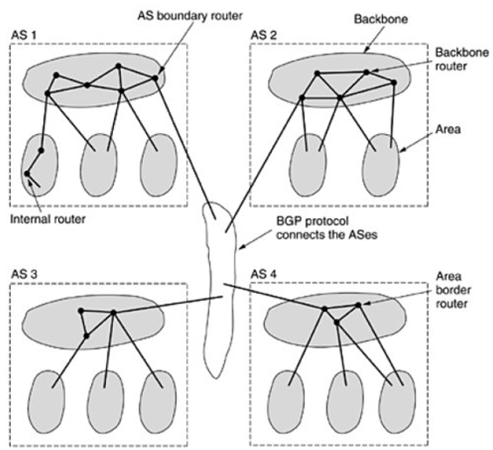
Autonomous Systems (ASes)
During normal operation, types of routes are:
i. Internal routers are wholly within one area.
ii. Backbone routers are on the backbone.
iii. Area border routers connect two or more areas.
iv. AS boundary routers talk to routers in other ASes.

Slide 7
Four types of Routers
Internal Router:
Router that has all its interfaces in the same area. All internal routers in an area have identical Link State Databases(LSDBs).
Backbone Router:
Router which resides in the backbone area. The backbone area is set to Area 0.
Area Border Router(ABR):
Routers that has interfaces attached to 2 or more areas. It can route between areas. ABRs acts as an exit points for the area.
AS Boundary Router(ASBR):
Routers that has at least one interface attached to external network (other autonomous system).

Slide 8
ROUTING INFORMATION PROTOCOL
(RIP)

Slide 9
RIP (ROUTING INFORMATION PROTOCOL)
RIP is an intradomain routing protocol used inside an autonomous system.
It is a very simple protocol based on Distance vector routing.
The entire structure is considered as a graph where nodes are the routers, and the links are the networks.
Metric in RIP is Hop Count.
The hop count is the number of networks required to reach the destination.
Infinity = 16. RIP should not have more than 15 hops and so it is used for smaller networks or small autonomous systems.

Slide 10
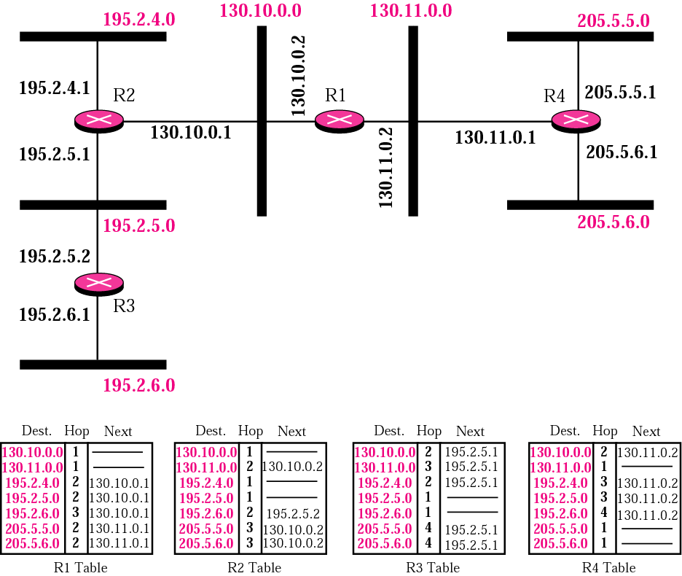
Example of a domain using RIP

Slide 11
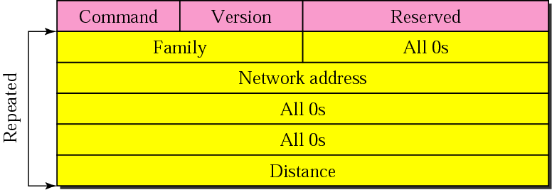
Figure. RIP message format

Slide 12
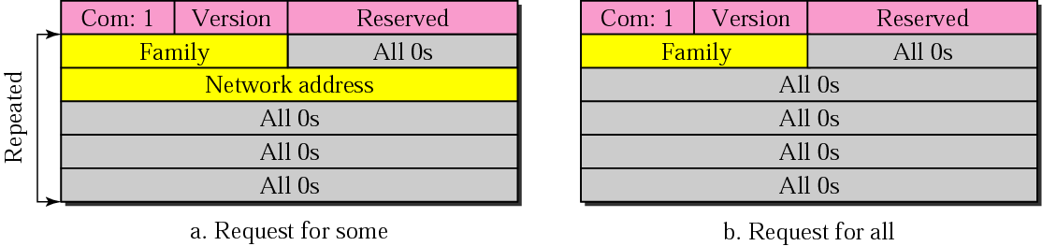
Figure. Request messages

Slide 13
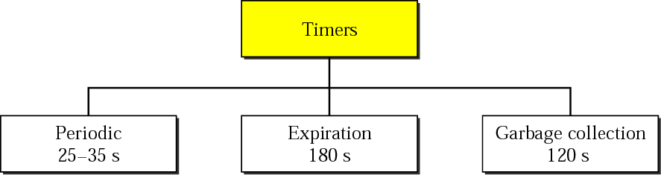
Figure. RIP timers

Slide 14
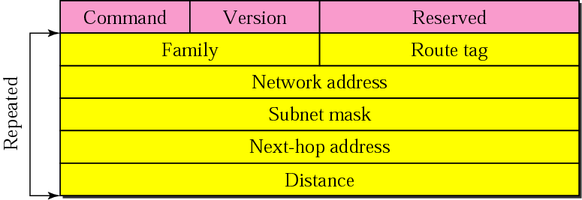
Figure. RIP version 2 format

Slide 15
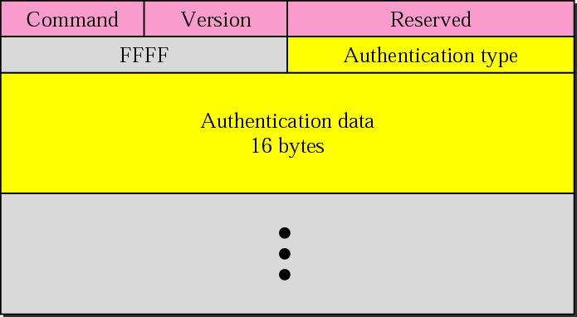
Figure. Authentication

Slide 16
Note:
RIP uses the services of UDP on well-known port 520.

Slide 17
OPEN SHORTEST PATH FIRST
(OSPF)

Slide 18
OSPF (OPEN SHORTEST PATH FIRST)
The OSPF stands for Open Shortest Path First.
It is a widely used and supported routing protocol.
It is an intradomain protocol, which means that it is used within an area or a network.
It is an interior gateway protocol that has been designed within a single autonomous system.
It is based on a link-state routing algorithm in which each router contains the information of every domain, and based on this information, it determines the shortest path.

Slide 19
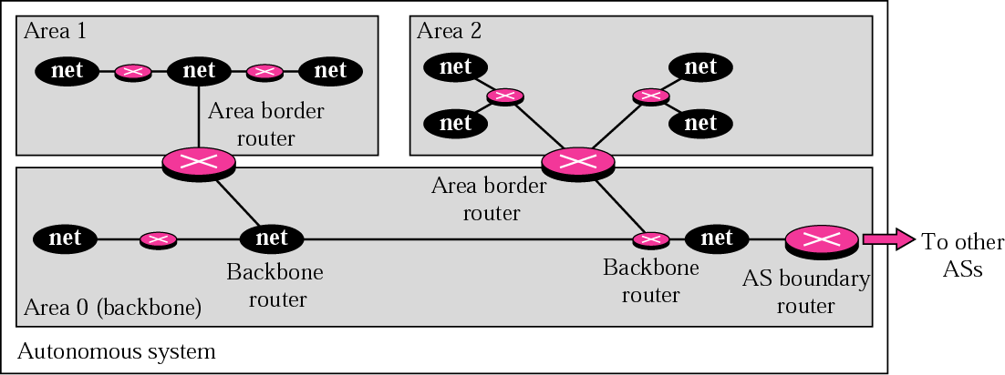
Figure Areas in an autonomous system

Slide 20
Routing using OSPF
Steps involved in OSPF Routing:
Step 1: To become OSPF neighbors.
The two connecting routers running OSPF on the same link creates a neighbor relationship.
Step 2: To exchange database information.
After becoming the neighbors, the two routers exchange the LSDB information with each other.
Step 3: To choose the best route.
Once the LSDB information has been exchanged with each other, the router chooses the best route to be added to a routing table based on the calculation of SPF.

Slide 21
Routing using OSPF…
When a router boots, it sends HELLO packet and multicasts.
It starts to exchange information between adjacent routers by sending the following OSPF messages
DESIGNATED ROUTER- HELLO packet
LINK STATE UPDATE – provides sender costs to its neighbors
LINK STATE ACK – acknowledge link state update and each message has a sequence number to detect whether an incoming LINK STATE UPDATE is older or newer.
DATABASE DESCRIPTION - gives the sequence numbers of all links state entries held by sender.
LINK STATE REQUEST – request information from partner.
Once the Link state information is obtained from the neighbor nodes, a router will compute the shortest path.

Slide 22
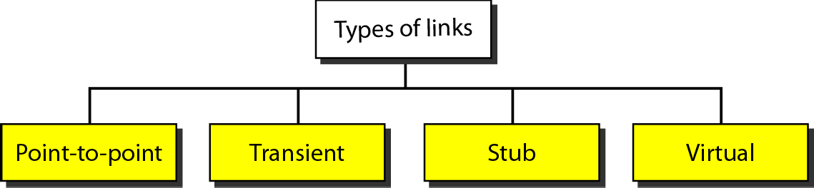
Types of links

Slide 23
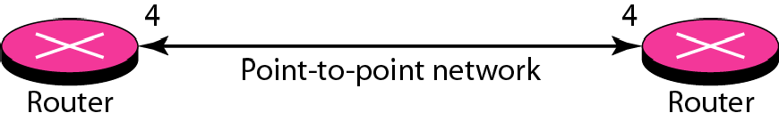
Point-to-point link

Slide 24
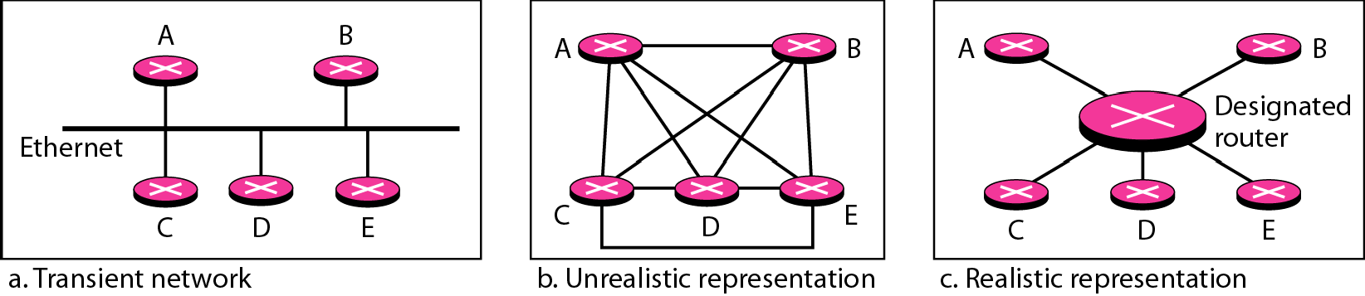
Transient link

Slide 25
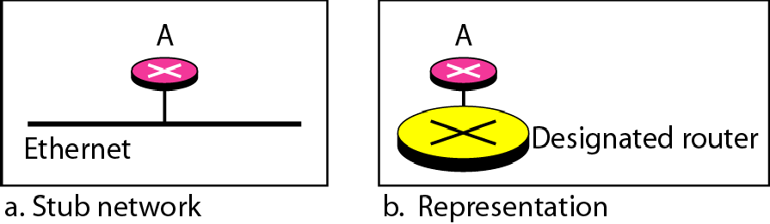
Stub link

Slide 26
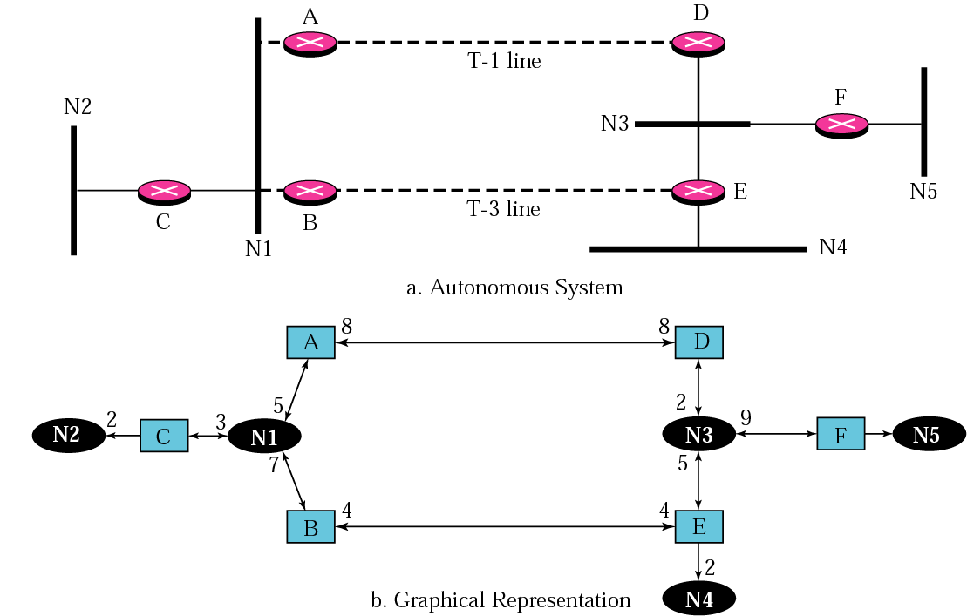
Figure Example of an AS and its graphical representation in OSPF

Slide 27
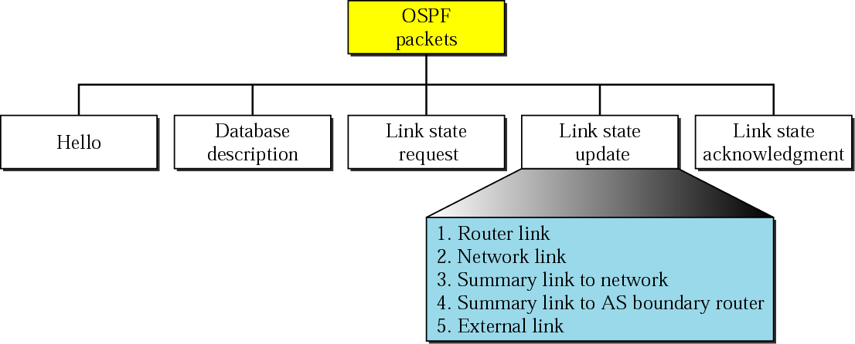
Figure Types of OSPF packets

Slide 28
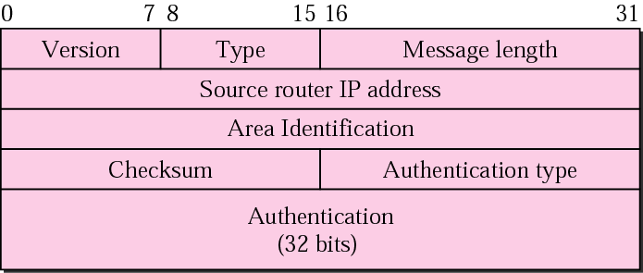
Figure OSPF common header

Slide 29
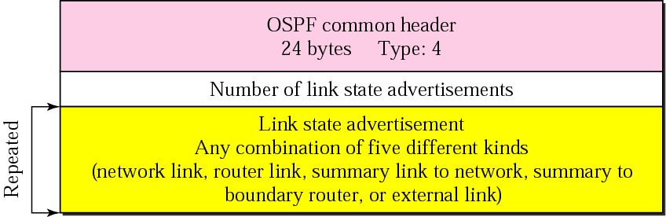
Figure Link state update packet

Slide 30
Note:
OSPF packets are encapsulated in IP datagrams.

Slide 31
BORDER GATEWAY PROTOCOL
(BGP)

Slide 32
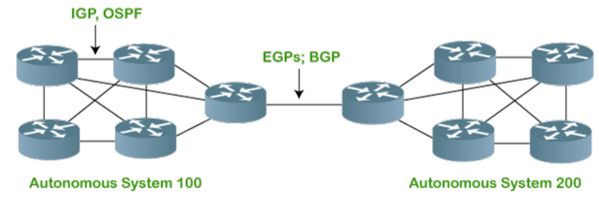
BGP (BORDER GATEWAY PROTOCOL)
Border Gateway Protocol (BGP) is an interdomain routing protocol.
Also named as Exterior Gateway Protocol(EGP).
It is a gateway protocol that is used to exchange routing information among the autonomous system on the internet.

Slide 33
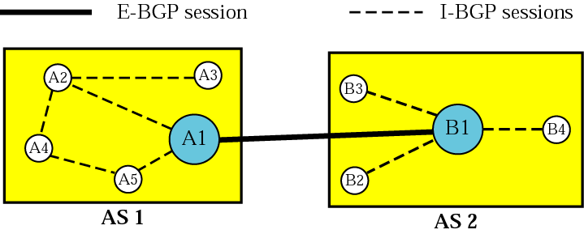
Figure Internal and external BGP sessions

Slide 34
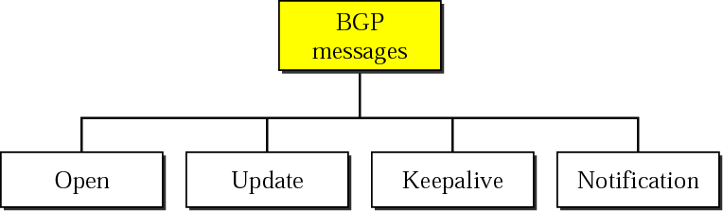
Figure Types of BGP messages

Slide 35
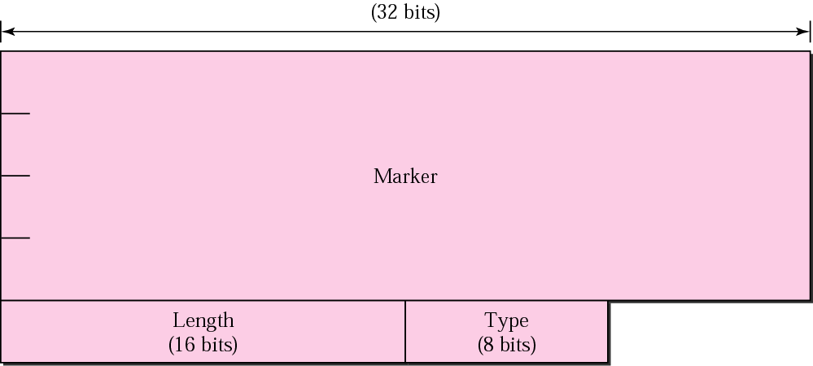
Figure BGP packet header

Slide 36
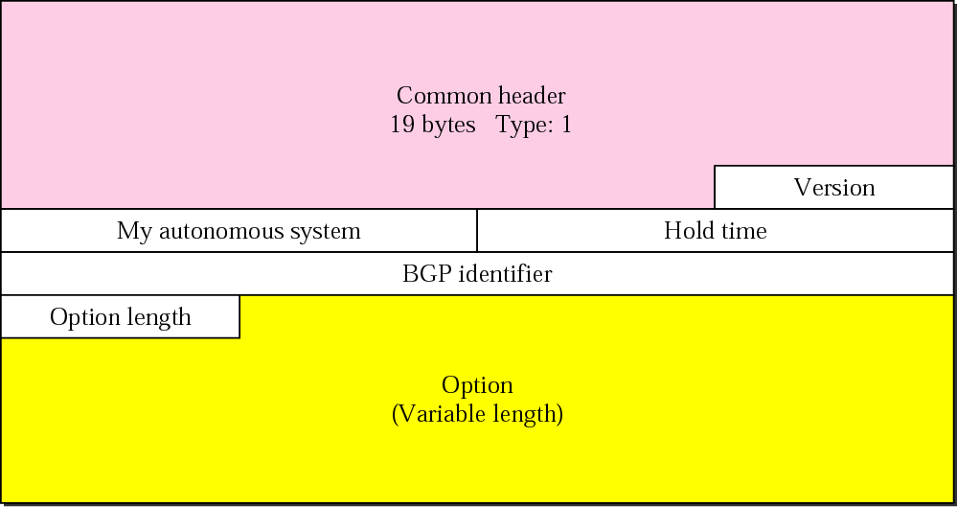
Figure Open message

Slide 37
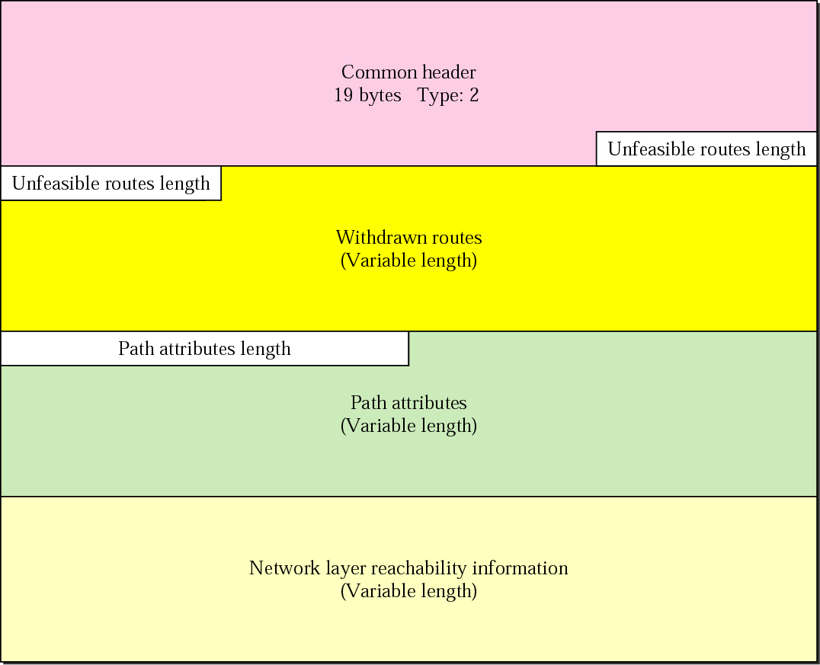
Figure. Update message

Slide 38
Note:
BGP supports classless addressing and CIDR.

Slide 39

Figure. Keepalive message

Slide 40
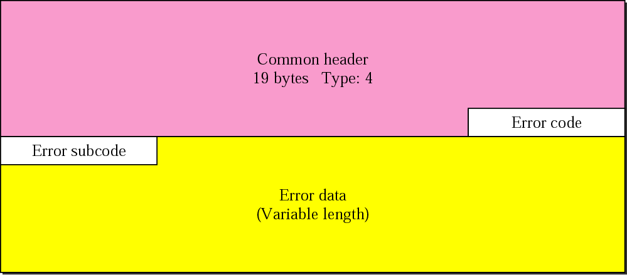
Figure. Notification message

Slide 41
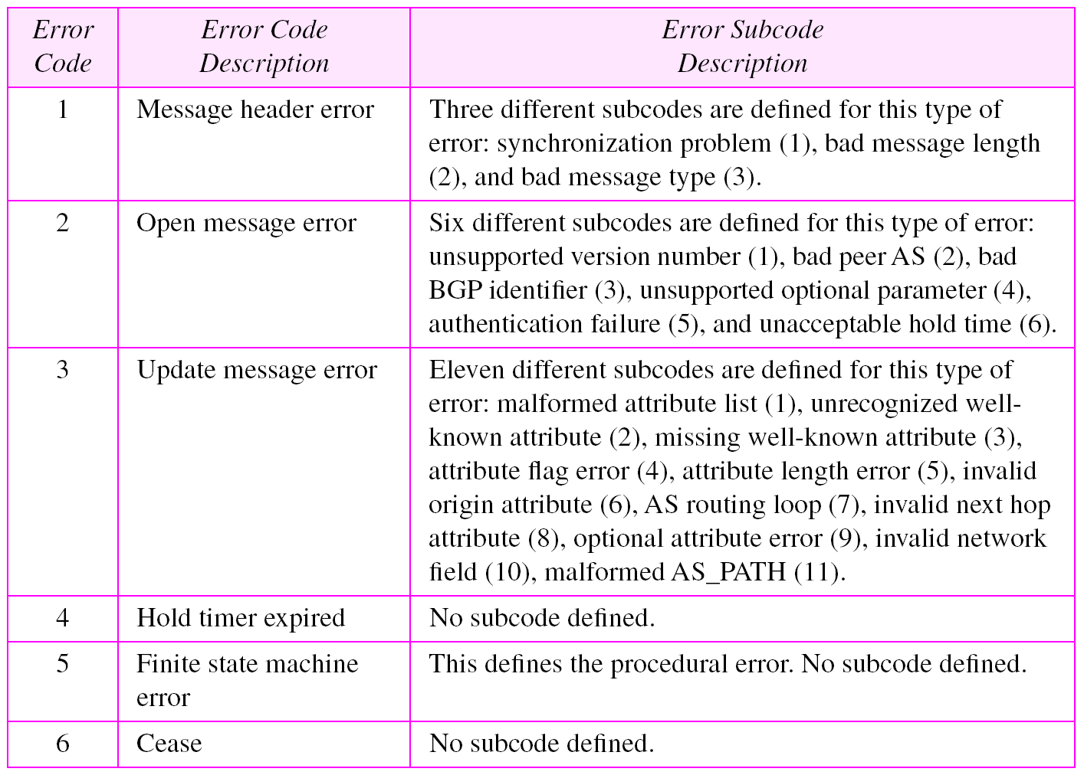
Table Error codes

Slide 42
Note:
BGP uses the services of TCP on port 179.

Slide 43
THANK YOU
Team –Network Protocols and Security

